Slide 1
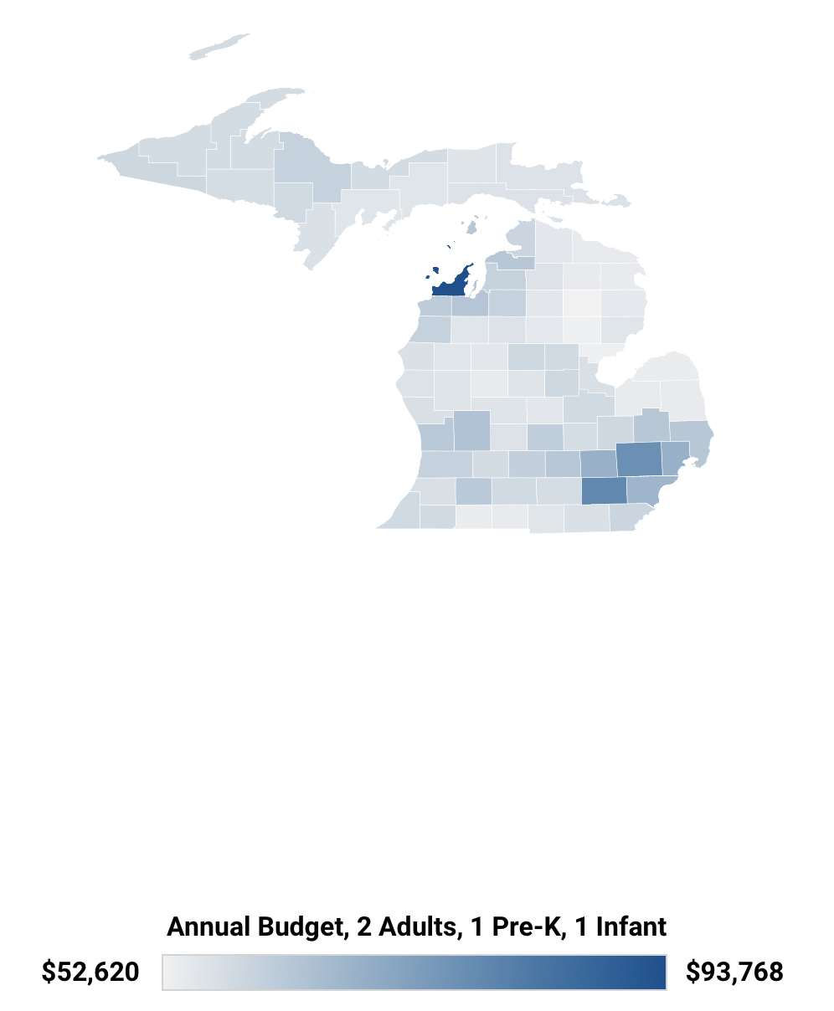
ALICE 2023 Asset Limited, Income Constrained, Employed
County | 2023 | 2021
Antrim | 39% | 34%
Benzie | 36% | 38%
Charlevoix | 36% | 37%
Grand Traverse | 36% | 33%
Leelanau | 46% | 43%
Michigan Cost of Living per County
How do we compare? MI = 39%
Bingham | 40% | Kasson | 54%
Centerville | 47% | Leelanau | 47%
Cleveland | 50% | Leland | 33%
Elmwood | 54% | Solon | 47%
Glen Arbor | 24% | Suttons Bay | 44%
Notes:
Source:
United Way ALICE data, methodology and reports - Leelanau Profile link is: https://www.unitedforalice.org/county-profiles/michigan

Slide 2
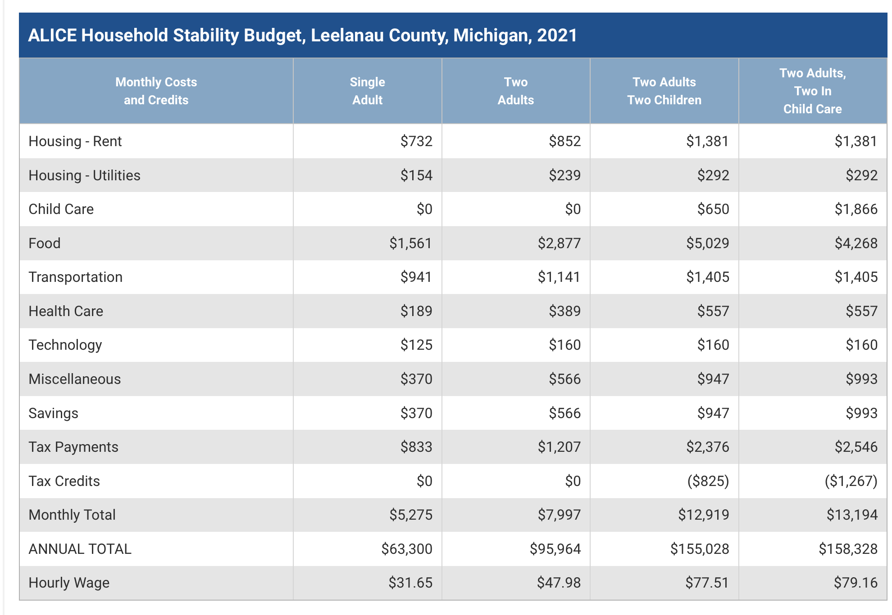
ALICE 2023 – the ‘disappeared’ middle class Essentials increased 3.4% compared to CPI 1.8%
Home Price to Income Ratio 5.5
(2x recommended; NYC level)
Average cost in northern Leelanau is $1,300 per month per child
40% of households in northwest Michigan are food insecure
Notes:
Sources:
Link to Essentials Index, background and methodolody on each cost category and more: https://www.unitedforalice.org/essentials-index
United Way ALICE data, methodology and reports - Leelanau Profile link is: https://www.unitedforalice.org/county-profiles/michigan

Slide 3
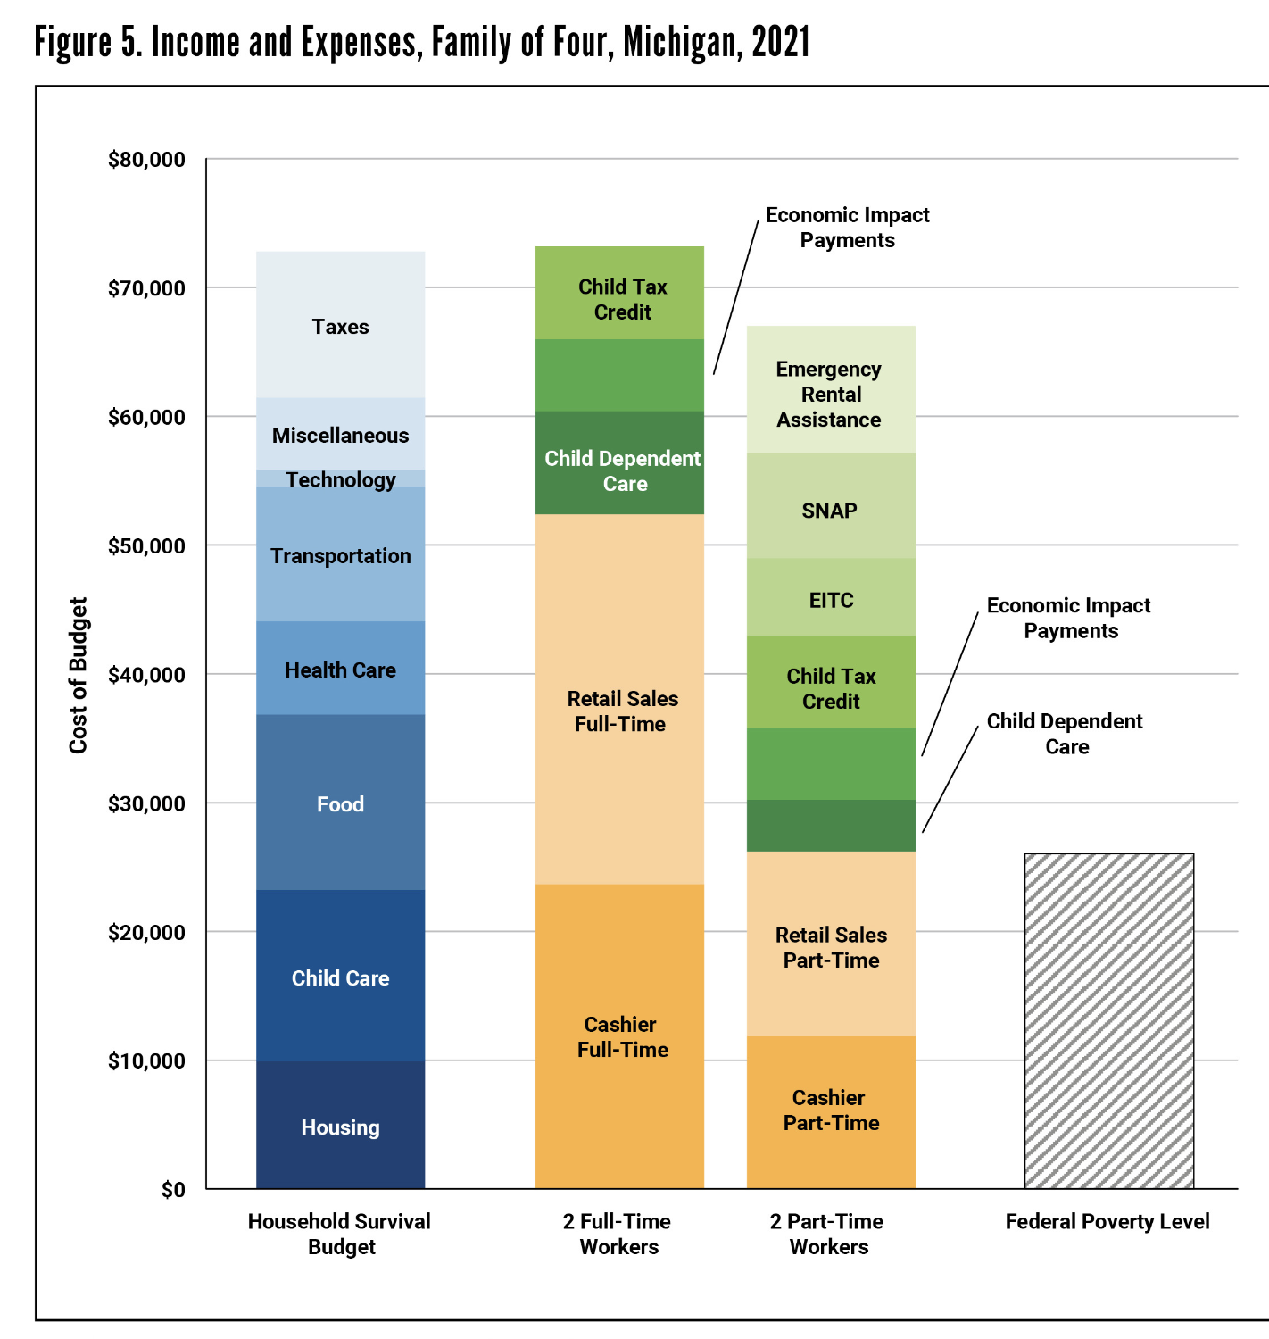
ALICE 2023 Pandemic support measures covered ‘survival’, but, with the end of such measures, now what?

